Slide 1
Magnet and RF Cavity
Test Stand Design
Tom Peterson, SLAC
USPAS
January, 2017

Slide 2
Outline
Test dewars and test stands
  Saturated bath test dewars
  Double bath test dewars
  SRF test cryostats
  SRF cryomodule test stands
  Horizontal magnet test stands
Procurement and assembly

Slide 3
Saturated bath vs. subcooled
Accelerator magnets are often cooled with subcooled liquid
  Typically working near the limit of the superconductor with large stored energy
  Ensure complete liquid coverage and penetration
Superconducting RF cavities are generally cooled with a saturated bath
  Large surface heat transfer in pool boiling for local “hot spots”
  Very stable pressures, avoid impact pressure variation on cavity tune

Slide 4
Saturated bath dewar
Simple, in principle
  Essentially a “bucket” of liquid helium
Entirely at saturation pressure
Very stable pressure and temperature
Low heat load due to simple “hanging” construction of inner vessel

Slide 5
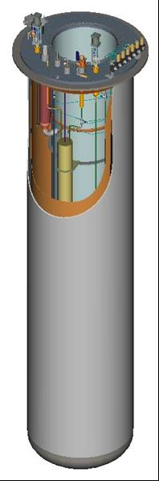
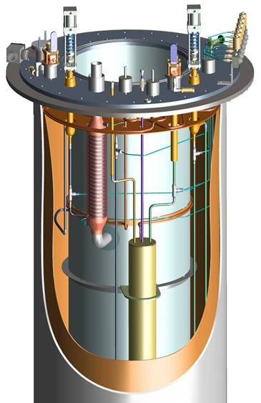
Saturated bath dewar

Slide 6
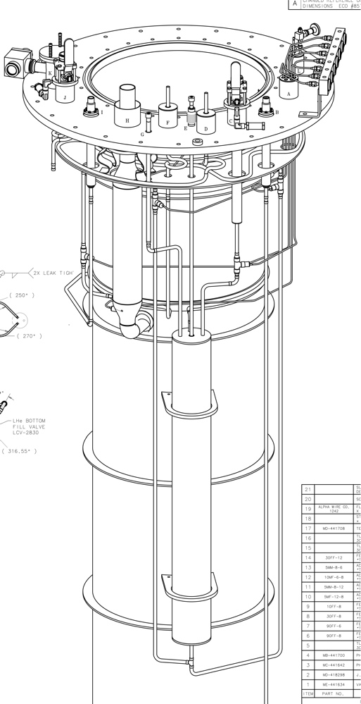
Saturated bath RF cavity test dewar
4.5 K to 2 K heat exchanger
(pumped flow precooling supply)
Supply helium phase separator
Liquid helium space with RF cavity

Slide 7
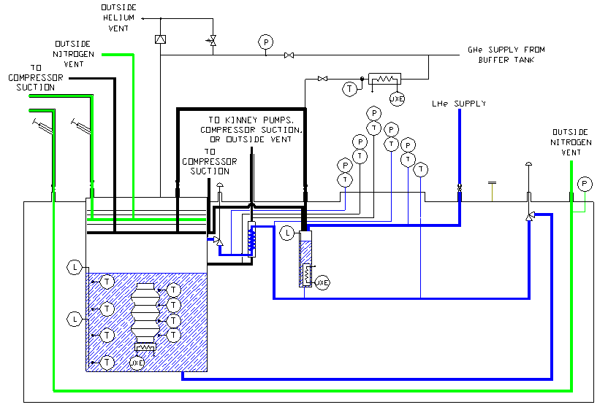
Saturated bath dewar schematic
2 K saturated bath
Top and bottom fill lines

Slide 8
Saturated bath dewar issues
Subatmospheric if less than 4.2 K
  Many potential air inleaks if < 4.2 K
  Air inleak may appear as operational problem without a clear cause
    For example, low pump-down or cool-down rate
Large volume of liquid presents venting problem with loss of insulating vacuum to air
  As much as 4 W/sq.cm. heat deposition on bare surface
  Venting may be a design challenge for a low pressure vessel (large pipes, etc.)
  We use MLI even under a thermal shield in order to reduce venting flow rate with loss of vacuum

Slide 9
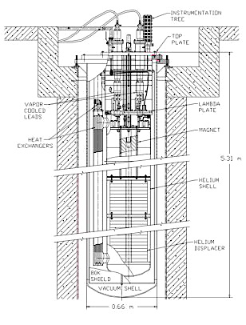
Double-bath dewar
4.4 K liquid above 1.2 bar, 2 K liquid
So 2 K liquid is subcooled, single phase liquid
4.4 K above is saturated
Separated by a “lambda plate”
Also low heat load

Slide 10
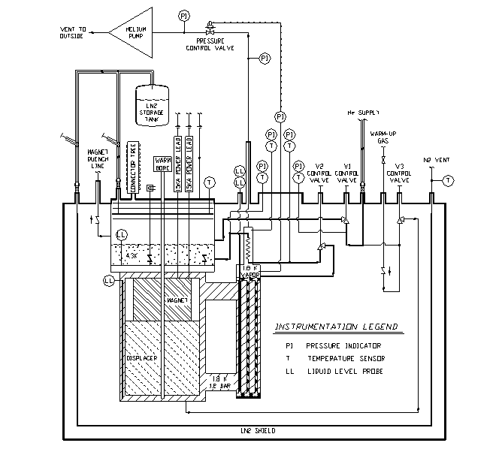
Double-bath flow schematic
Large helium pump
Large, vertically oriented heat exchanger between saturated bath and pressurized helium permits operation with normal, subcooled helium as well as superfluid
4.5 K vol
Lambda plate
Saturated bath at 2 K
2 K vol

Slide 11
Double-bath dewar
Mostly positive pressure
  Provides subcooled liquid
Seal between 4.3 K and sub-lambda regions is a heat transfer barrier
  Need not be hermetically tight
  Key feature is to provide long, thin path for heat transport, so leaks should be long
  Flat seal rather than “knife-edge”

Slide 12
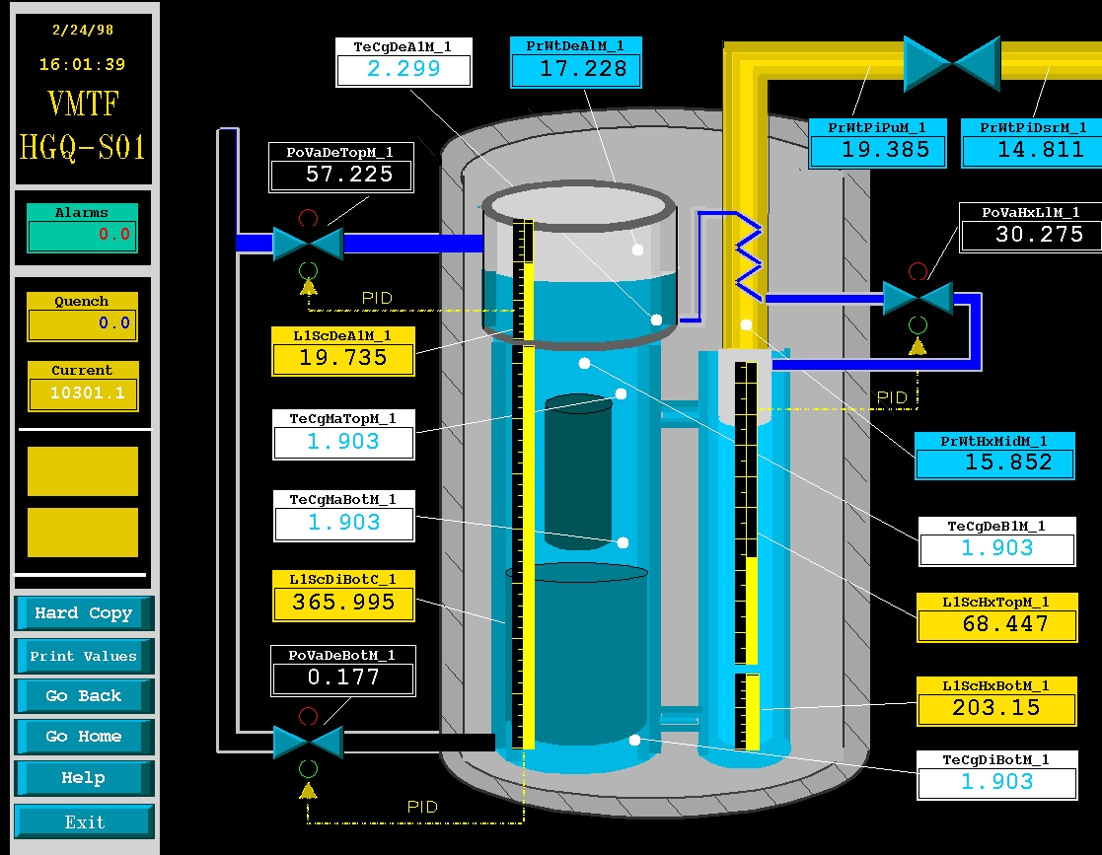
Double-bath control screen

Slide 13
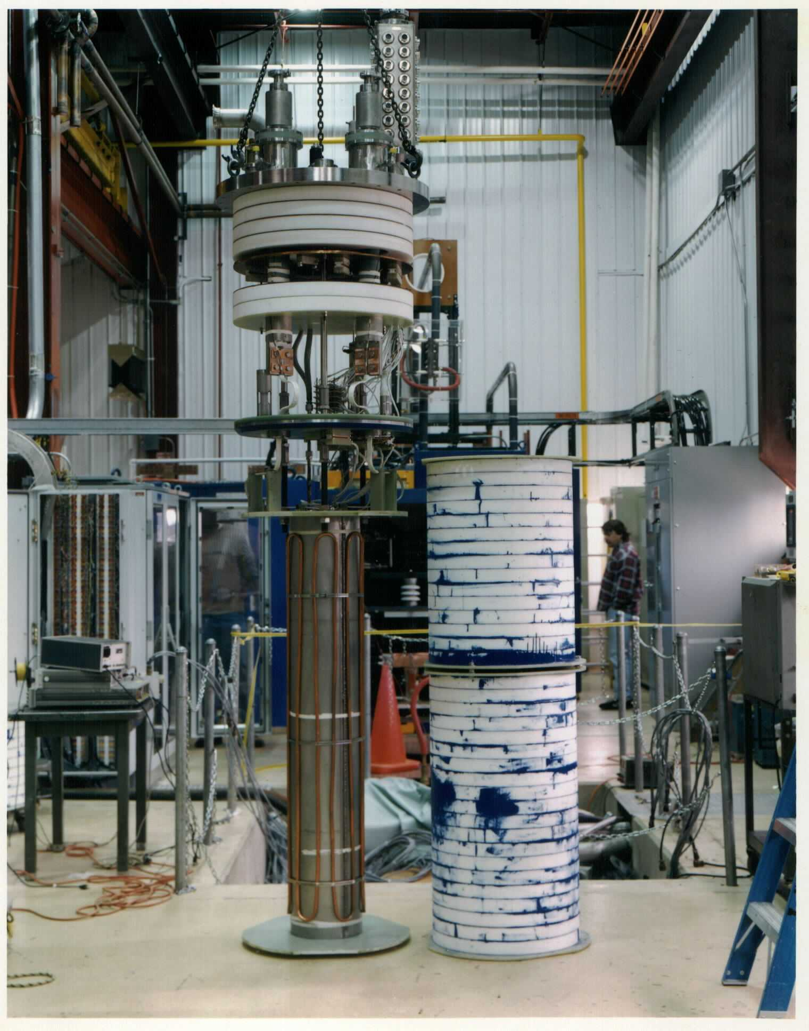
Double-bath insert assembly
Top plate
Closed-foam (Rohacel) insulation
4.4 K vapor space
Lambda plate
Magnet
Displacer

Slide 14
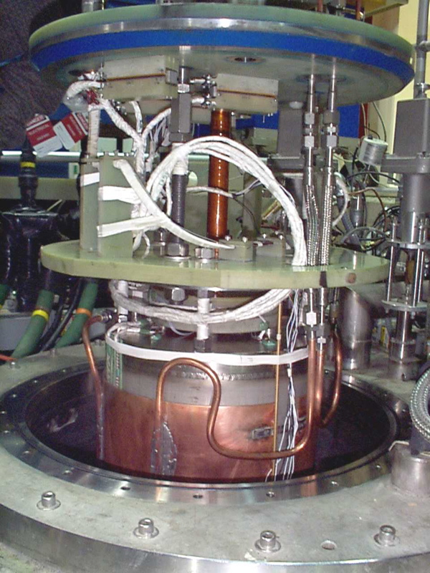
Lambda plate assembly
Lambda plate and seal (blue)
Intermediate support plate
Copper clad magnet (for cooldown)

Slide 15
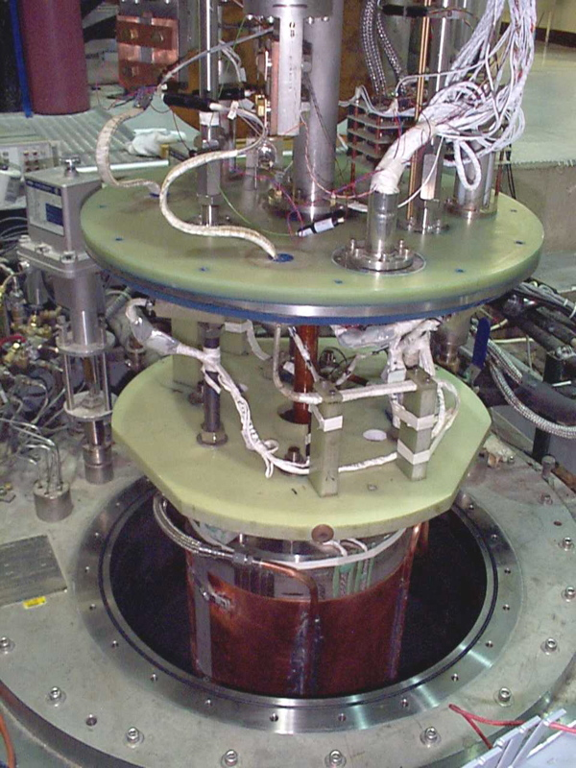
Lambda plate assembly another view
Lambda plate and seal (blue)
Intermediate support plate
Copper clad magnet (for cooldown)

Slide 16
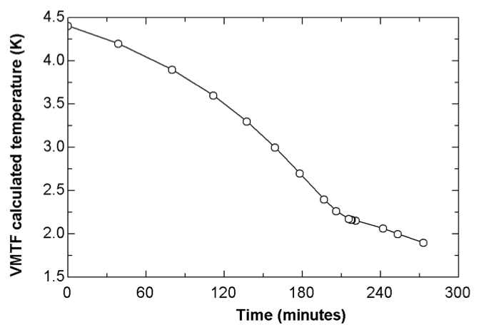
Double-bath cool-down
Predicted double-bath cool-down based on pumping rate and helium properties

Slide 17
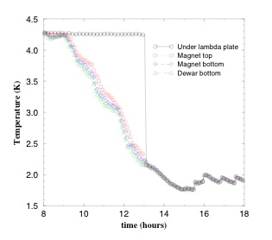
Pressurized SF cooldown
Single phase, 1.2 bar liquid
Temperatures equilibrate below lambda point

Slide 18
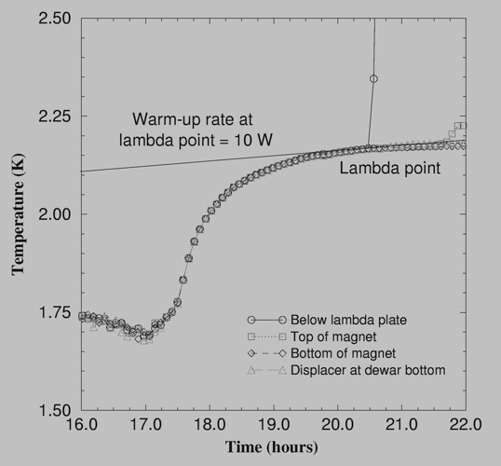
Pressurized SF warm-up
Sub-lambda point warm-up shows non-linear effects
  SF heat transport
  Heat capacity
  Pressurization of associated saturated bath
But essentially isothermal SF bath is excellent calorimeter

Slide 19
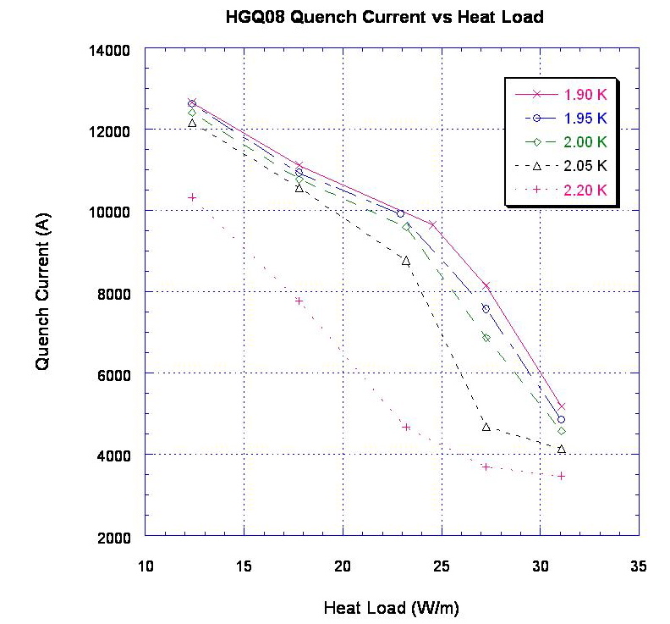
Impact of SF heat transport on magnet quench current, measured in a double-bath dewar

Slide 20
Double-bath dewar issues
Subatmospheric portion of dewar is more limited than in the completely saturated bath dewar, so less extensive but still important to be leak tight
Heat transport via a “lambda” seal between normal and SF is a problem
  Seal must be tight with long leak paths
  Heat loads come from various sources, so difficult to distinguish lambda seal leak from others

Slide 21
Barriers between superfluid and normal fluid
Lambda plate, lambda plug (detailed example in part 3), check valve (later in this talk)
If the barrier plane is oriented horizontally and the 4.5 K bath above is quiescent, the bath above slowly stratifies to 2.17 K just above the barrier
In fact one can operate a “double bath” without a lambda plate down to 2.2 K
  A 2 K heat exchanger below the surface will subcool the liquid
  There will still be a 4.4 K layer and positive vapor pressure on top -- vapor and liquid surface equilibrium
Fermilab routinely tests magnets in subcooled liquid in the positive pressure vertical dewar

Slide 22
Some Common Thermal Prediction Errors
Thermal intercept temperature assumption, overestimating conduction, free convection thermal “short”, incidental contact

Slide 23
Thermal intercept temperatures
A common source of underestimated heat loads is analysis which assumes ideal thermal intercept temperatures, for example 77 K or even 80 K for an LN2 thermal intercept, when in fact due to thermal resistance of long thermal strap connections, nitrogen or helium pressure, or other factors, the thermal intercept temperature is higher than assumed.
The following example for the vertical test cryostat which I just described illustrates the issue.

Slide 24
Analysis for two sets of assumptions
Compare calculated
heat loads with thermal
intercepts at 100 K vs
80 K and at 6 K vs
4.5 K.
Not a huge difference,
quite realistic.

Slide 25
Estimated heat for test dewar

Slide 26
Intercept discussion
Other factors dominate 1.8 K heat load here, so focus on 4.5 K
Effect on the estimate is 18.7 W → 25.8 W
This is a 38% increase
The higher one is a realistic estimate
  LN2 system actually operates at the dewar pressure, with flow control downstream of the dewar, so about 50 psig, 4.5 atm absolute, 93 K
  Thermal straps are often undersized for 4.5 K intercepts
  Contact resistances for intercepts are underestimated

Slide 27
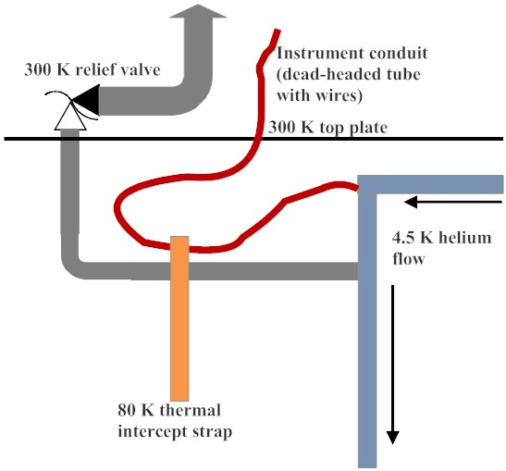
What is wrong
with this design?

Slide 28
Another common problem
Free convection
  Within relief valve lines
  In dead-headed cool-down lines
  In instrumentation lines
May even generate thermo-acoustic oscillations
  Larger heat load to 4.5 K
  Vibrations

Slide 29
Lesson
Critically examine assumptions in thermal analyses
Specify thermal intercepts in detail
Include thermal intercept links, straps, contact resistances, and real fluid temperatures in the analysis
Look at temperature gradients in the fluid in dead-headed lines and possible free convection drivers

Slide 30
Back to Test Stands

Slide 31
Horizontal test stands
Horizontal -- simply as opposed to vertical orientation of a long magnet or SRF cavity in a typically vertically oriented dewar
May consist of just end boxes
  A supply box for power and cryogens
  A turnaround box
  Test object in its own cryostat
  Interconnects to the end boxes
Or may be more like a horizontal vacuum chamber or horizontally oriented dewar
Like vertical test dewars, may provide saturated bath or subcooled liquid

Slide 32
Features due to horizontal configuration
Not such a simple support structure
Helium container typically needs separate enclosure within vacuum container
  Test device typically not hanging but supported with low thermal conductivity structure within the vacuum space
  Installation of test device more complicated

Slide 33
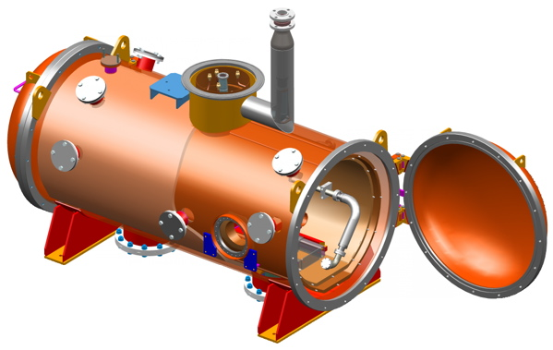
SRF cavity test cryostat
CAD model of vacuum chamber for SRF cavity tests
Designed for tests of RF cavities which are pre-installed into helium vessels

Slide 34
SRF cavity test cryostat
Helium vessel with RF cavity slides in, then cryo pipes and RF coupler connected

Slide 36
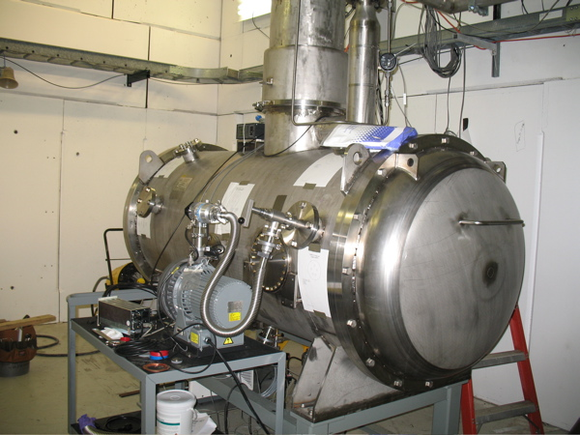
SRF horizontal test stand
Fermilab SRF cavity test cryostat
Stainless vacuum shell
Rubber O-ring seals vacuum door
Copper thermal shields
Cryogenic piping in top
Indium metal seals connect cryogenic piping

Slide 37
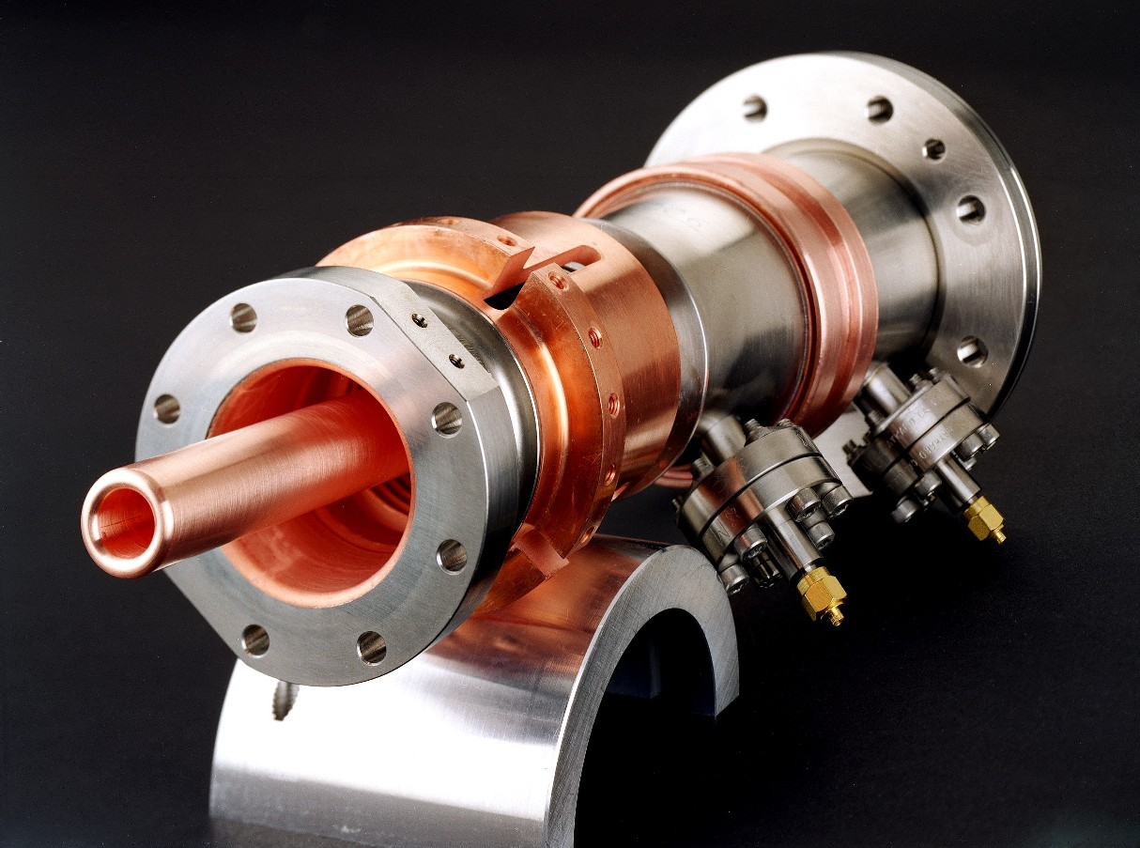
RF power input coupler
Carries RF from 300 K to 2 K in horizontal test stand
Thin sections and thermal intercepts
Conductor is copper plating on stainless

Slide 38
Providing 2 K on a test stand
Test stand refrigeration requirements are typically small
  A large, 2 K cryoplant will not be available
  4.5 K helium from either a small liquefier or storage dewars will provide refrigeration
  Room-temperature vacuum pumps provide the low pressure for the low temperature helium
  Small heat exchangers may be incorporated for continuous fill duty

Slide 39
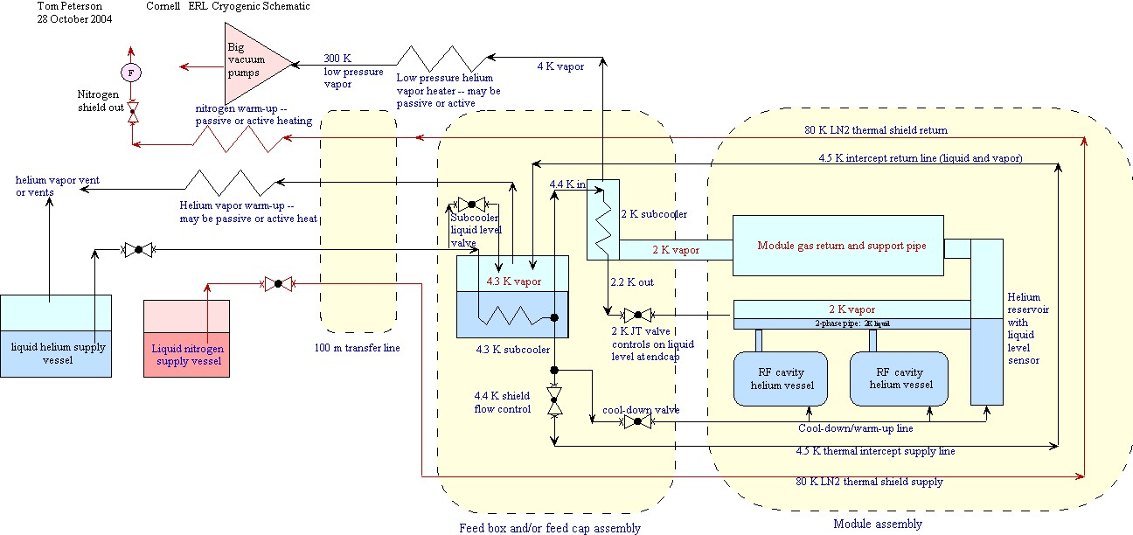
Horizontal SRF test stand

Slide 40
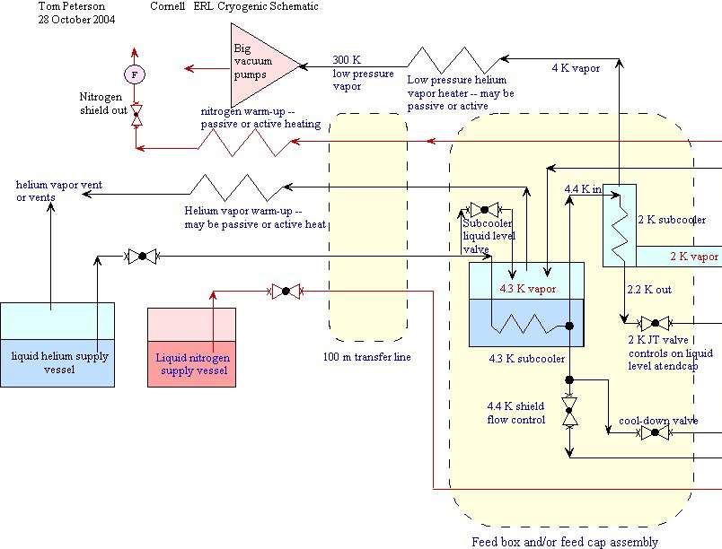

Slide 41
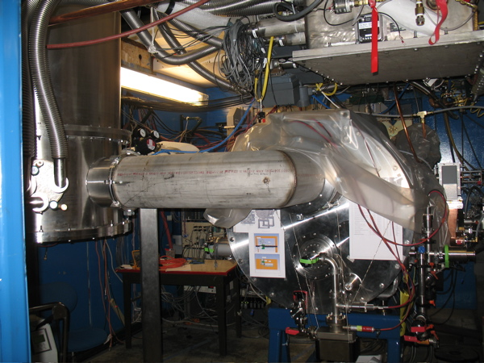
SRF horizontal test stand
Cornell SRF cavity test cryostat
Helium supply from left into end of cryostat

Slide 42
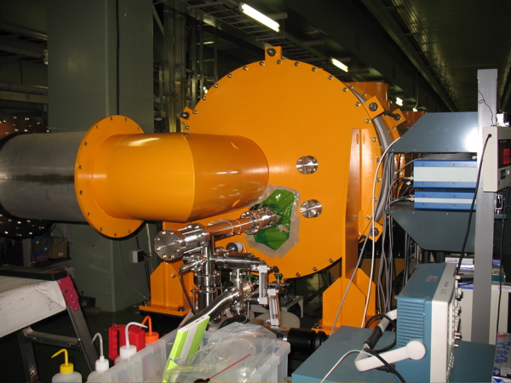
SRF cryomodule test stand
KEK STF feed box

Slide 43
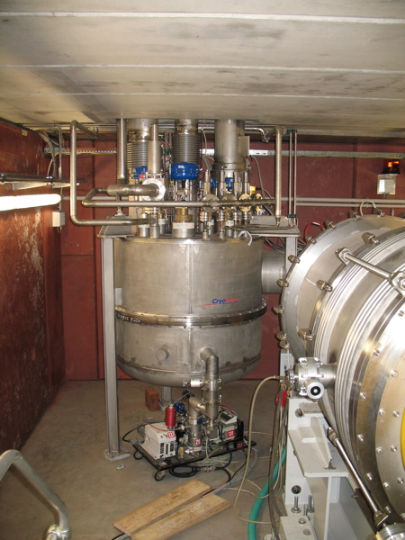
SRF Cryomodule Test Stand -- DESY - 1
Feed box
Cryogenic connections to cryoplant out through top

Slide 44
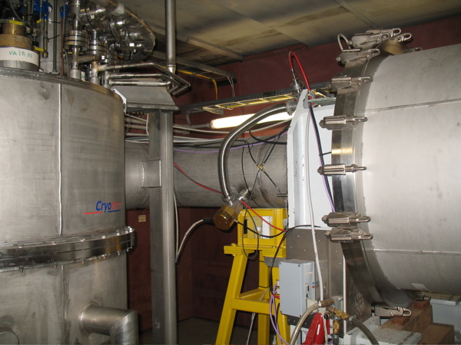
Cryomodule Test Stand -- DESY - 2
Feed box and connection to feed interconnect
Note similar configuration to Cornell and KEK

Slide 45
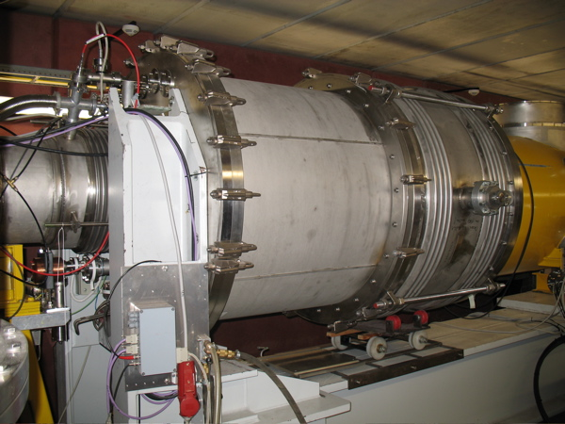
Cryomodule Test Stand -- DESY - 3
Feed-end interconnect
1 m dia
Bellows slide back for access

Slide 46
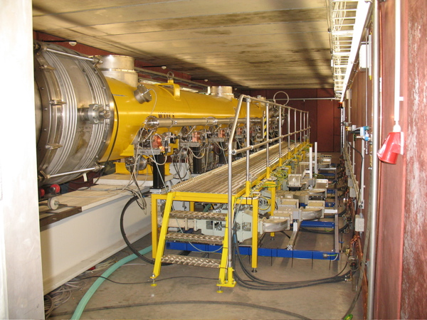
Cryomodule Test Stand -- DESY - 4
Cryomodule on test stand
RF distribution under platform

Slide 47
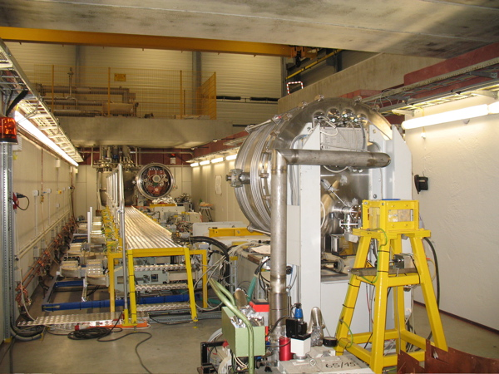
Cryomodule Test Stand -- DESY - 5
Test stand with cryomodule removed
View from turnaround end

Slide 48
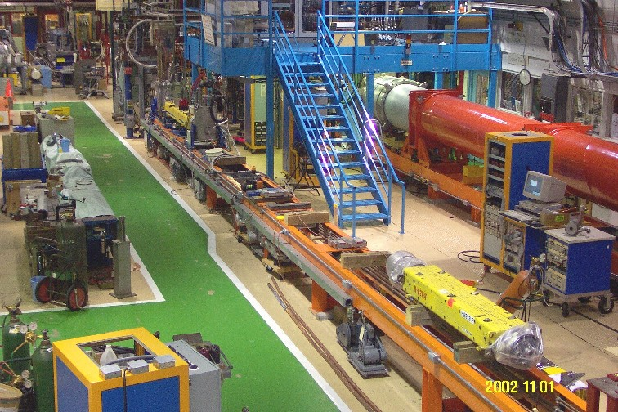
Horizontal magnet test stand
Magnet test stands at Fermilab

Slide 49
Magnet “test stand 5”
Our first superfluid magnet test stand at Fermilab, in the 1980’s
Provided stagnant or forced flow operation
4.5 K to 1.8 K
Illustrates use of local test stand heat exchangers in combination with large warm vacuum pumps to provide sub-lambda helium

Slide 50
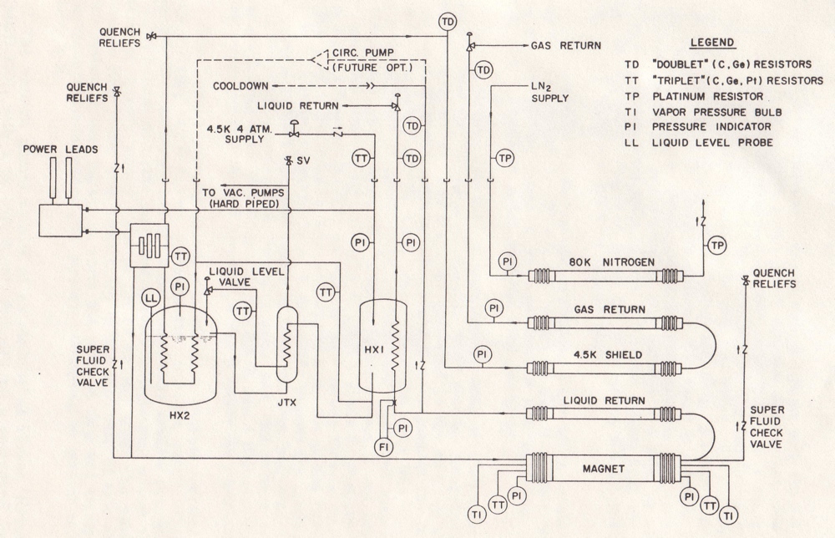
Superfluid magnet test stand 5

Slide 51
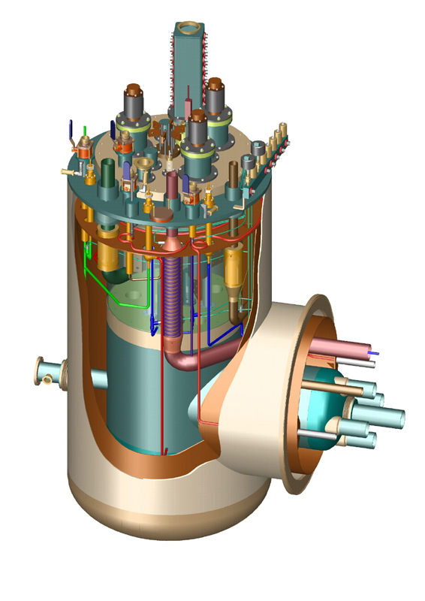
Feed box for LHC magnet test
Essentially a double-bath with a horizontal extension
Current leads and instrumentation in on the top

Slide 52
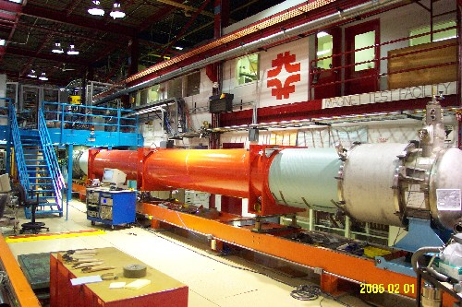
Horizontal magnet test stand
LHC magnet test stand at Fermilab

Slide 53
Long pipe cool-down with SF
Temperature at the far
end of a 15 m long,
42 mm inner diameter,
Cool-down line, with a
small heat input at
the far end
Temperature in a large
volume of subcooled
liquid helium, slowly
warming up

Slide 54
More long-pipe temperatures during cool-down and warm-up
Plot shows temperature
history over two days,
consisting of a forced-flow
filling at 4.5 K early
December 2, cool-down
from 4.5 K to 1.9 K in
stagnant helium, a quench
and recovery the evening
of the 2nd, an overnight
warm-up, cool-down the
morning of the 3rd, and
finishing with a quench
the afternoon of the 3rd.

Slide 55
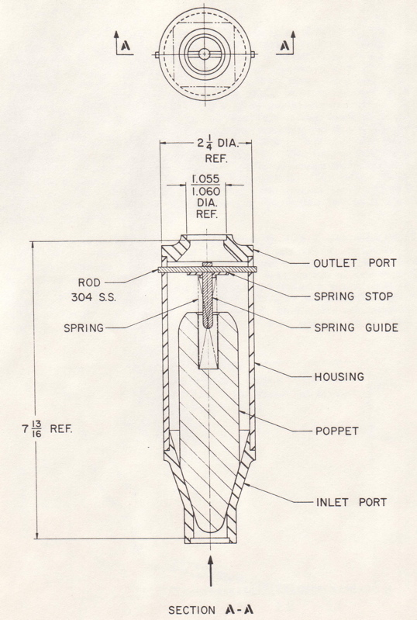
Superflluid check valve
Long, conical seal for long heat flow path
Tiny, axial through-hole for pressure equalization

Slide 56
Procurement strategies
Design and build in-house
Design and procure “to print”
Detail interfaces and critical areas but not entire object -- procure to spec’s and drawings
Performance specification with only a few key interfaces detailed

Slide 57
Procurement experience
Test vessels and stands with end boxes are typically unique -- one or a few-of-a-kind
Industry is small and specialized
Designs often contain new, risky, or erroneous features
Close collaboration with a vendor is critical
  Frequent (once per week or more) inspections and meetings at the vendor

Slide 58
Design, procurement, installation time scale
Design of a new cryogenic box
  0.5 or more man-years engineering
  1.0 or more man-years drafting
  Typically 6 - 9 months calendar time
Procurement -- another 6 - 12 months
Installation
  Complexity of instrumentation, controls, interfaces are often underestimated
  Several months
Result -- two years or more

Slide 59
Operations
Common problems encountered
  Warm gas in adds large amount of heat
    A very small leak via a valve isolating warmer helium from the lower temperature system may be a hidden source of heat
    1 mg/sec at 300 K ==> 1.5 Watts to 4.5 K!
  Air leak in (contamination)
    Subatmospheric operation for sub-4.2 K provides risk of air inleaks, especially through instrumentation and other seals

Slide 60
More about operations
Instrumentation
  Often in doubt
  In situ checks like at a phase change can provide verification of temperatures and pressures
  We generally allow a period of “thermal studies” upon startup of a new test system
    Check instrumention
    Review operating procedures
    Verify thermal performance

Slide 61
References
More information about Fermilab’s and other test stands may be found in Cryogenic Engineering Conference (CEC) and International Cryogenic Engineering Conference (ICEC) proceedings.
Here is a sample for Fermilab:
  P.O. Mazur and T.J. Peterson, “A Cryogenic Test Stand for Full Length SSC Magnets with Superfluid Capability,” Advances in Cryogenic Engineering, Volume 35A, pg. 785.
  T. J. Peterson, et al, “A 1400 Liter 1.8 K Test Facility,” Advances in Cryogenic Engineering, Volume 43A, pg. 541.
  R.H. Carcagno, et al, “A Cryogenic Test Stand for LHC Quadrupole Magnets,” Advances in Cryogenic Engineering, Volume 49A, pg. 225.

